Slide 1
PRESENTATION TITLE
Author
Presentation Subtitle

Slide 2
BUILD YOUR FUTURE
Firefox OS for OEMs

Slide 3
FIREFOX IS A CATALYST FOR INDIVIDUAL
AND COLLECTIVE PROGRESS

Slide 4
MAIN HEADLINE:
36PT OPENS SANS EXTRABOLD ITALIC
  Body text in Open Sans 24 pt. Line spacing is set on single.
Use Bold to highlight an important point.
Use full returns between paragraphs of information. Keep it simple: don’t use bullet points for every thought.

Slide 5
HEADLINE FOR TEXT SLIDE
CAN BE ONE OR TWO LINES
Avoid starting your presentation text
with bullets.
Use them when you need to drill down into
the full details of your main points.
Separate main points with a full return.
Avoid text that goes all the way across the page: it’s hard to read. Use the ¾ mark in the grid as the maximum width of your paragraphs (the Master pages are already set up this way).
    — Use an “M” dash for all levels of bullets

Slide 6
KEEP YOUR HEADLINES
SHORT AND TO THE POINT
You can also use half of the page when you need to show images and text.
Use the grid to size, align
and keep space between
the images.
Can’t see the grid? Right-click an empty area of the slide or the margin around the slide, point to “Guides,” then click “Static Guides.”

Slide 7
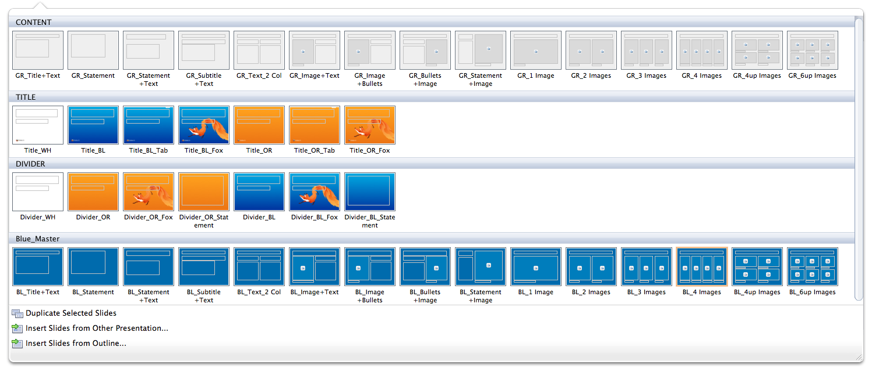
THIS DOCUMENT IS SET UP
WITH MASTER PAGES
Use the pull-down menu on
the New Slide button on the Home tab to choose from the four available Master pages:
Content
Title
Divider

